Slide 1

Data Structure ‘ C’ - SemIII (22317)
Presentation Made By
Shafaque Julaha(Sr.lecturer. Computer)
M. H Saboo Siddik Polytechnic

Slide 2
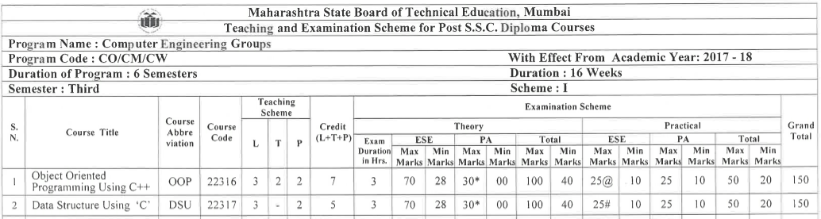
Syllabus Structure

Slide 3
Data Structure
Unit I – Introduction to Data Structures (6 marks)
Unit II – Searching and Sorting(12 marks)
Unit III – Stacks and Queues(20 marks)
Unit IV—Linked Lists(16 marks)
Unit V– Trees and Graphs(16 marks)

Slide 4
Unit I – Introduction to Data Structures (6 marks)

Slide 5
Data structure
Define a way to store and organized data in a computer , so that it can be used efficiently.
DS deals with the knowledge of :
-- how data should be organized ?
-- how flow of data should be controlled ?
-- choosing effective data structure to increase efficiency of an algorithm.

Slide 6
Need of DS
A DS helps us to understand the relationship of one data element with other.
List of names of months have linear relationship.
Location of historical places in country have hierarchical relationship
Country --→ State --→ City-→ Place

Slide 7
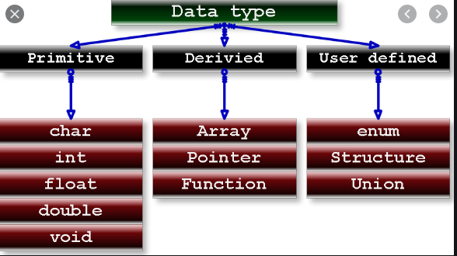
Data Types
type def

Slide 8
Data Types
Primitive Data types :
Define how data will be stored , organized and retrieved from memory .
Eg : int , float , char double.
User defined data types :
rename an existing data type and give it a user defined name.
Eg : Typedef , Structure , Union

Slide 9
Typedef :
syntax : typedef datatype new datatype ;
eg : typedef int units;
typedef float percentage;
Derived data type :
Derived are constructed from basic data types.
Eg : Array , pointer

Slide 10
Abstract Data type (ADT)
Implementation of mathematical model specified by ADT.
ADT is the specification doesn’t imply implementation .
Implementation involves translation of ADT
specification into any programming language.
Eg : int data type in c can be considered as an set of numbers of
{-1,-2…….} {1 , 2, ……..}
ADT integer also specify the operation that can be performed on integer number like addition , subtraction.

Slide 11
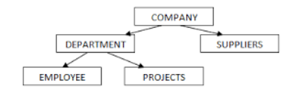
Classification of Data Structure
Linear DS :
data elements organize in linear fashion ,where data elements are attached one after the other.
Non linear DS :
-- data elements are not stored contiguously in memory.
-- Non linear DS are used to represent data containing hierarchical relationship

Slide 12
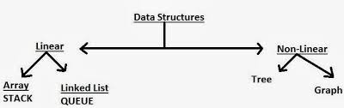
Classification of Data Structure

Slide 13
Operations on Data Structure
Traversing : processing each element in the list exactly once.
Searching
Inserting
Deleting
Sorting
Merging

Slide 14
Algorithm
An algorithm is a finite sequence of instructions which can be carried out to solve a particular problem.
Example
Characteristics:
Input
Output
Definiteness : steps should be clear.
Finiteness : proper start and ending
Effectiveness: should be written in basic instruction.
--assign -- i/p --o/p --branch

Slide 15
Different approaches for designing an algorithm:
Top Down approach :
identifying the major components of the system , decomposing them into lower level components.
Like programming done using functions.
2. Bottom Up approach :
Designing the most basic components and proceed to the higher level.
It follows information hiding.

Slide 16
Algorithm Analysis
Analysis of algorithms is the determination of the amount of time and space
Checking algorithm for predicting its efficiency.
3 cases :
Best case : minimum time that algorithm will require for input of size n .
Worst case : maximum time that algorithm will require for input of size n
3. Average case : average time that algorithm will take for input of size n
Example : running time for sorting algorithm will depend on the ordering of the data input.

Slide 17
Complexity
Is a function which determine how much running time/memory space is needed by algorithm in order to run to completion.
Complexity of an algorithm is classified as
1. Time Complexity
2. Space Complexity

Slide 18
1. Time complexity
Is the amount of computer time that algorithm needs to run to completion.
3 different types of time complexity:
-- Best case time complexity
--Average case time complexity
--Worst case time complexity

Slide 19
Time complexity measure , by focusing on frequency count for all key statements.
Example :
Algo A : a=a+1
Frequency count of algo A is 1
So , Time complexity of algo A is 1
Algo B : for x=1 to n
a=a+1
loop
Frequency count of algo B is n
So , Time Complexity of algo B is n
Algo C : for x=1 to n
for y=1 to n
a=a+1
loop
Frequency count of algo C is ?
So , Time Complexity of algo C is ?
n2

Slide 20
2. Space Complexity
Amount of memory that an algorithm needs to run to completion.
Fixed space requirements : this includes the space for fixed size variables, constants.
Variable space requirements : this consist of space needed by variable whose size depend on particular instance of variable.
example :

Slide 21
Big ‘ O ‘ Notation
Big O notation is a way of describing algorithm efficiency.
We can express time complexity with notation known as Big O notation.
Big O Notation abbreviated as Capital O
Eg : F(n) = O(n) can be read as
complexity of function f on n is big O of n

Slide 22
Big ‘ O ‘ Notation
Example :
Time Complexity of search algorithm of size n
In Worst case : f(n)=O(n)
In Best case : f(n)= O(1)
In Average case : f(n)=O(n/2)
Common computing time of algorithms are as follows :
O(1) : constant time.
O(n) : Linear time.
O(n2) : polynomial time.
O(log n) : logarithmic time.

Slide 23
Array
Int a[20] ; n=5
A[0] a[1] a[2] a[3] a[4] a[5]…a[19]
10 20 30 40 50
Num=60 index=2
For( i=n ; i>index ; i--)
a[i]=a[i-1]
a[index] =num;
n=n+1

Slide 24
Int a[20] ; int n=5;
A[0] a[1] a[2] a[3] a[4] a[5].. a[19
10 20 30 40 50
index=2
For(i=index ; i<n-1 ;i++)
a[i]=a[i+1];
n=n-1; n=4

